Slide 1
Joins
Amrom Obstfeld MD PhD

Slide 2
Session | Instructor

Slide 3
Goal: Provide a clear understanding of the fundamental concepts of joins
Objectives:
Objective 1: Explain the purpose and importance of joins in data analysis.
Objective 2: Describe the mechanics of left joins and inner joins, highlighting their differences.
Objective 3: Demonstrate how to apply joins to solve real-world problems in a lab/healthcare setting.
Notes:
Obviously we would love for those who are here today to all walk away and just start coding but the reality is that while that would be great we also have a set of more modest if more important goals
We're here to Advocate for the use of R as a means of improving reproducibility in clinical data analysis and I cannot emphasize enough how strongly we feel about this point
As we review this we will demonstrate how we can use R perform analyses of laboratory operational data
And we also hope to establish a baseline understanding of what tidy data is and how to implement a 'tidy' approach to data analysis within the framework of R

Slide 4
HPI:
CAP is inspecting your lab and one of the inspectors asked your chair what your top performed test is.
Your chair surreptitiously texts you as he distracts the inspector with some free Nespresso

Slide 5

Your Turn
Connect to the MIMIC IV database and determine:
Q: What the most commonly ordered lab test is in the database?
Notes:
Great now that we are all acclimated I thought it would be nice if we could all drop our info into the chat so that we can all get a sense for who is in the workshop, just type in your name, and briefly why are you attending the workshop.

Slide 6
Overall analytic strategy
Read data from LABEVENTS table
Group by the itemid column
Count the number of rows per group
Arrange from large to smallest count
Top row is the winner!
ItemID 50971

Slide 7
What is itemid 50971?
Audience suggests ways to figure this out

Slide 8
What is itemid 50971? Analytic Strategy
Plug 50971 into View of LABITEMS
or
Read LABITEMS |> filter itemid==50971

Slide 9
Your Turn
Connect to the MIMIC IV database and determine:
Q: What the most commonly ordered lab test is in the database?
A: Potassium!
Q: What are the top 10 ordered lab tests?

Slide 10
Joins
Notes:
I'm here just to give you a quick introduction after which we'll dive right into the meat of the workshop.

Slide 11
Challenge

Slide 12
Who are we?

Slide 13
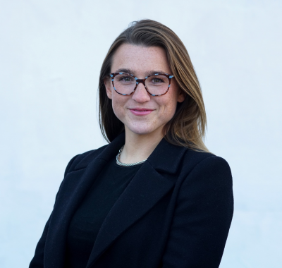
Sarah Dudgeon
PhD Candidate, Department of Laboratory Medicine, Yale University School of Medicine
Notes:
Sarah Dudgeon is a PhD Candidate at Yale University where she studies graph analytics and other advanced mechanisms of multi-modal healthcare data analysis. She additionally has experience in medical device regulation with the FDA, a Master of Public Health in Epidemiology and Biostatistics from Johns Hopkins Bloomberg School of Public Health, and a Bachelor of Science from University of Michigan in Kinesiology minoring in Engineering.

Slide 14
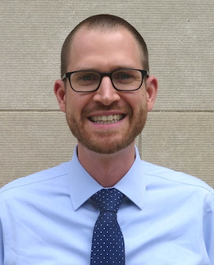
Joseph Rudolf
Assistant Professor, Department of Pathology, University of Utah Medical School
Medical Director, Automated Core Laboratory, ARUP Laboratories
Notes:
Joseph Rudolf, MD is the medical director for the automated core laboratory at ARUP Laboratories in Salt Lake City, Utah. His clinical and research interests focus on the intersection of informatics and clinical operations including clinical decision support, utilization management, and reporting and analytics. He is also passionate about clinical process improvement and initiatives to support quality and safety.

Slide 15
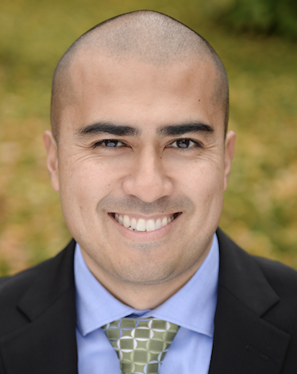
Patrick Mathias
Assistant Professor, Department of Laboratory Medicine and Pathology
University of Washington School of Medicine
Associate Medical Director, Laboratory Medicine and Pathology Informatics
Notes:
Patrick Mathias, MD, PhD, is the Associate Medical Director of the Informatics Division in the Department of Laboratory Medicine at the University of Washington School of Medicine. His interests include developing data science and analytics as a core competency to improve clinical lab operations and laboratory stewardship, and applying clinical informatics approaches to mitigate laboratory-associated diagnostic errors. He is interested in developing and improving programming and data science education across all levels of pathology practice.

Slide 16
Amrom Obstfeld
Associate Professor of Clinical Pathology and Laboratory Medicine
Director of Pathology Informatics
Children's Hospital of Philadelphia
Notes:
And this is me, Amrom Obstfeld MD, PhD, I am the Medical Director of the Division of Pathology Informatics at Children’s Hospital of Philadelphia. In this role I lead the development of analytic tools to aid in quality management and operations, interfaces with other groups throughout the hospital on informatics initiatives and I also in design and implement informatics educational experiences for pathology trainees and faculty at the University of Pennsylvania.

Slide 17
Workshop Workflow
Notes:
So now that you've met us let's discuss for a moment how this workshop is going to work

Slide 18
Your Turn
Introduce yourself to your breakout roommates
Who are you?
What institution are you from?
Why are you here?
Notes:
Great now that we are all acclimated I thought it would be nice if we could all drop our info into the chat so that we can all get a sense for who is in the workshop, just type in your name, and briefly why are you attending the workshop.

Slide 19
Final Tips
The best way to learn to code is by doing!
Google is your friend
Notes:
And just some final words before we begin, no matter what you're learning but particularly coding, the best way to learn is by doing:
Find a project, make a goal for yourself, push yourself to use R, it's OK to lean on some excel, we all do when we're starting out, but try to get that activation energy to get your hands typing code. We would not be teaching this course if we didn't strongly believe that R is accessible to all of you. So keep practicing and you'll get there.
With that let's get started with the workshop. Up next Joe will provide us with the basics of R and get us up and running with Rstudio Cloud.

